Slide 1

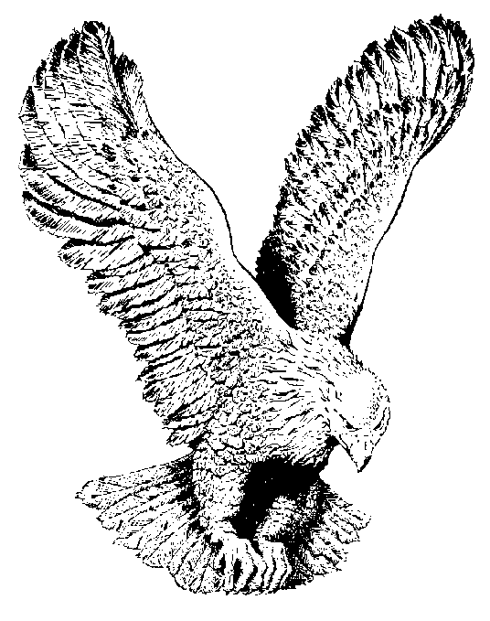
COME AND WORSHIP
Angels, from the realms of glory,
Wing your flight o'er all the earth;
Ye who sang creation's story
Now proclaim Messiah's birth:

Slide 2
Chorus:
Come, Come and.... Come and worship
Come and... Come and worship
Come and worship,
Worship Christ, the new-born king

Slide 3
Shepherds in the field abiding,
Watching o'er their flocks by night,
God with man is now residing;
Yonder shines the infant Light:
Every knee shall then bow down:

Slide 4
Sages, leaves your contemplations;
Brighter visions beam afar;
Seek the great Desire of Nations;
Ye have seen his natal star:

Slide 5
Saints before the altar bending,
Watching long in hope and fear,
Suddenly the Lord, descending,
In his temple shall appear:

Slide 6
Though an infant now we view him,
He shall fill his Father's throne,
Gather all the nations to him;
Every knee shall then bow down:

